Slide 1
Building and Architecture to Support Domain Modeling
CIDM 6330
Spring 2021

Slide 2
Principal Tools
Balancing Behavior and Architecture
A Test-Driven orientation
The use of Design Patterns:
Repository – abstracting persistence
Service Layer – abstracting the fulfillment of use cases and transactions
Unit of Work – Atomic and abstracted operations
Aggregate – Ensuring data integrity

Slide 3
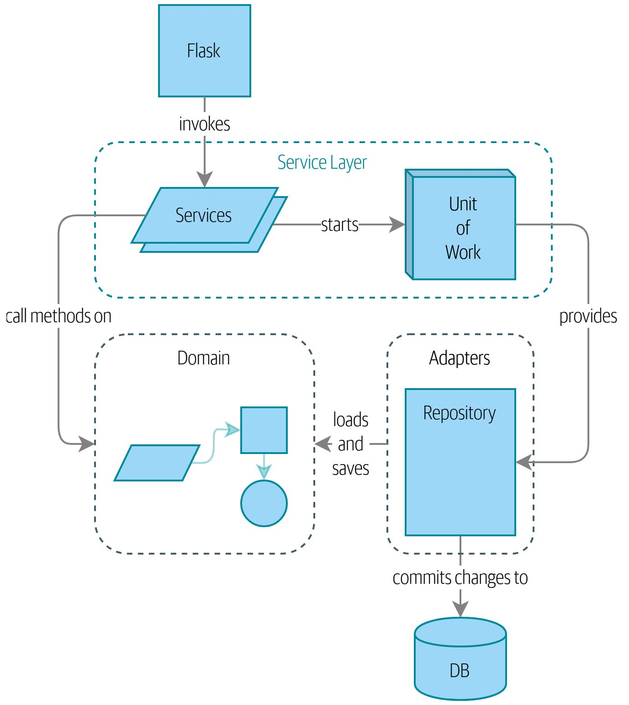
Roadmap

Slide 4
Domain Modeling
APP Chapter 1

Slide 5
Domain Modeling
Synonyms:
Business Logic Layer
Domain Model
Domain
“The ontological, epistemological, methodological, and social components that shape the problem you are trying to solve.”
Shaping the set of activities that support business processes that the system must implement
Model
“A map is not the territory”

Slide 6
Domain Model
The Domain Model is the mental map that an organization has of its business and its operations
All models are abstractions
Abstractions are a natural component of human reasoning

Slide 7
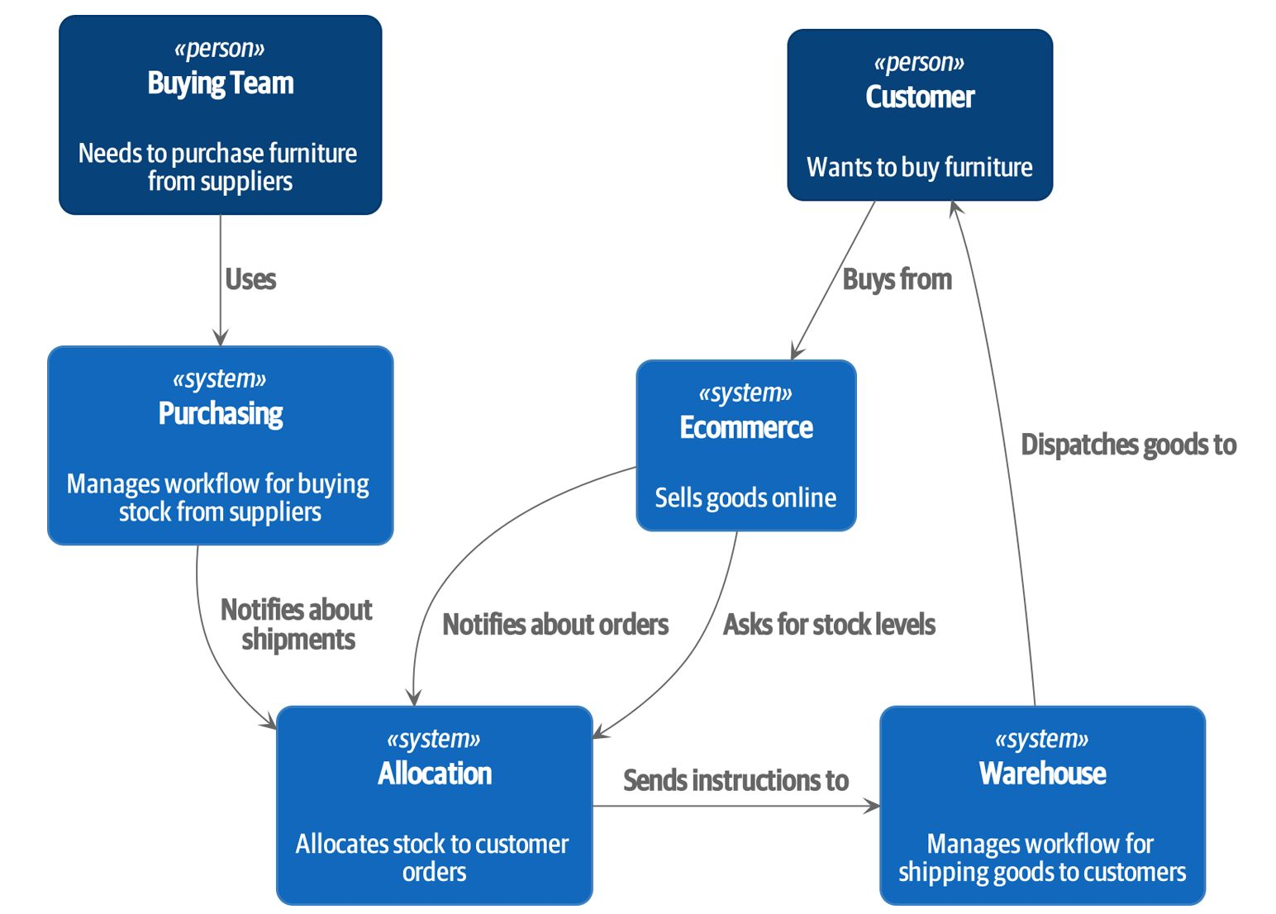
An illustration

Slide 8
Needs
Glossary of Domain Language
Some degree of ethnography is needed here
Validation and Verification
At all steps, a means for testing and validating assumptions is necessary
How?
How can you test the assumptions of your models as the system to fulfill the model comes into existence?

Slide 9
Python: Entering into Code
We will be coding…
Brushing up:
From the Python Software Foundation: https://www.python.org/about/gettingstarted/
Learn Python: https://www.learnpython.org/
W3Schools: https://www.w3schools.com/python/default.asp
Python Crash Course: https://ehmatthes.github.io/pcc/

Slide 10
Examining APP’s Early Example
Authors’ git repository: https://github.com/cosmicpython/code
They presume the use of Docker, I won’t be following that path
Let’s explore the rest of the chapter in code…

Slide 11
The Repository Pattern
APP Chapter 2

Slide 12
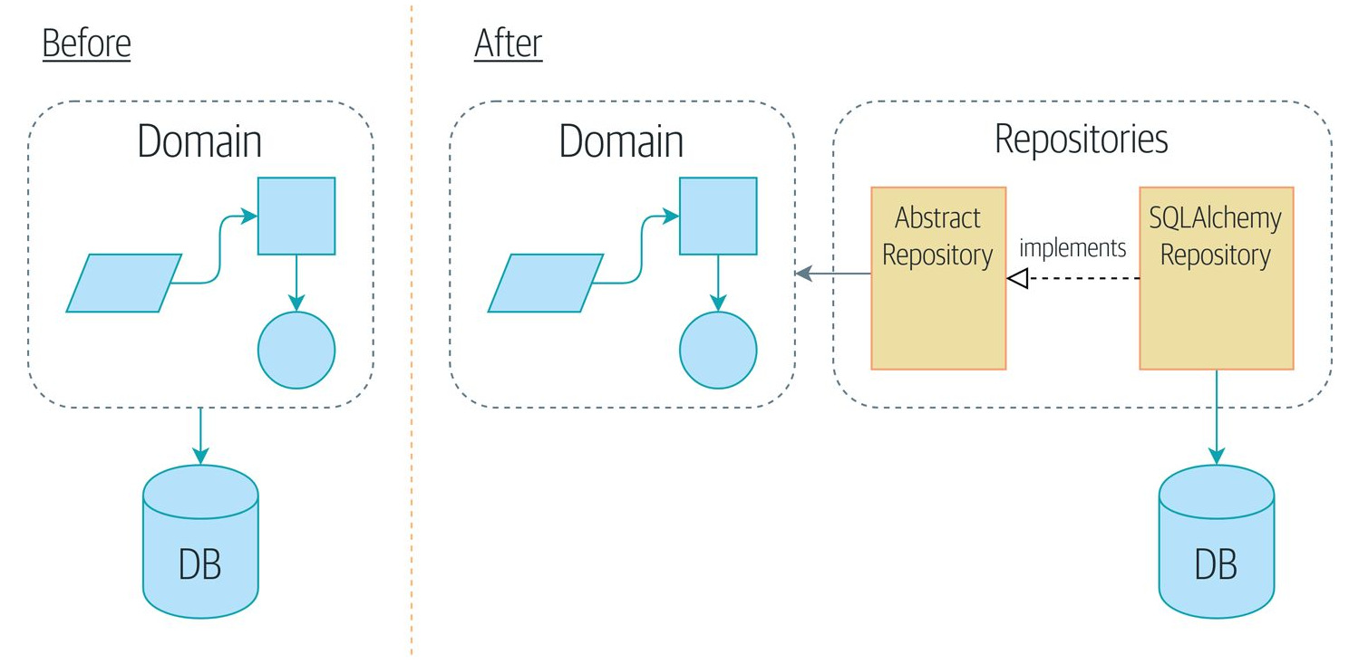
The Repository Pattern
Model-View-Controller

Slide 13
What is it?
This is an abstraction for persistence to decouple a domain model from the persistence layer
Sits between domain model and the database

Slide 14
How are we going to use it?
Web API that serves data using REST/HTTP
Will use Flask
The implementation framework is a detail (see the last part of Martin’s book)

Slide 15
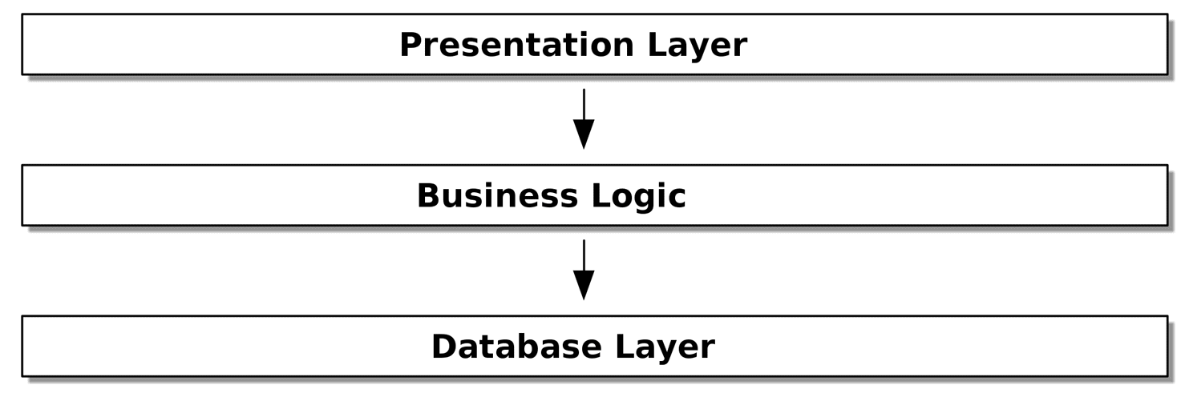
Typical Architectures as Layers

Slide 16
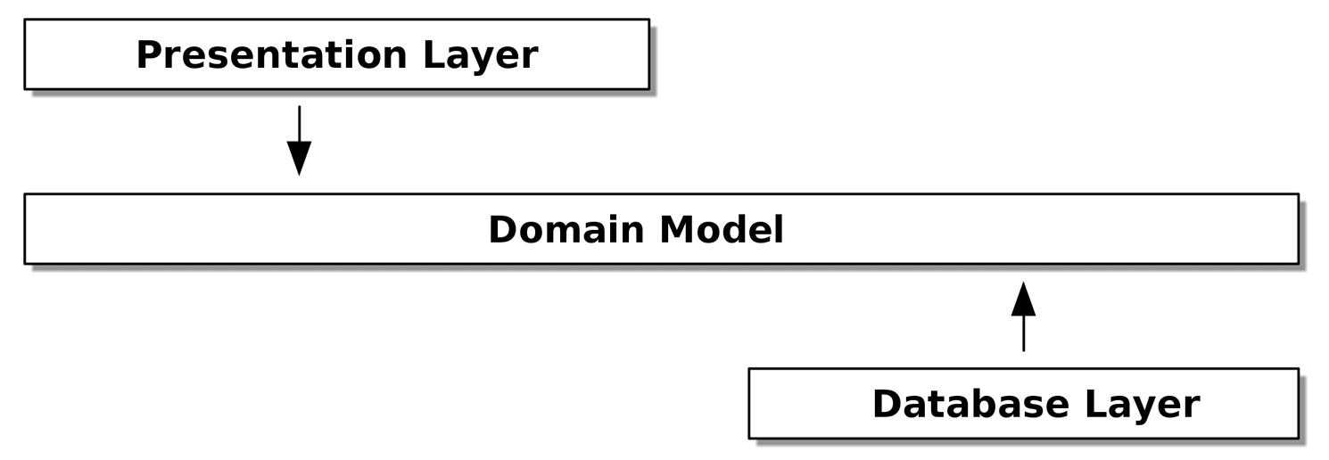
Spanning (overextending) the Domain Model

Slide 17
Quick Aside
Unified Modeling Language Review: http://agilemodeling.com/essays/umlDiagrams.htm
Behavioral
Interaction
Structure
Let’s Review Them
I will require that you use them at times

Slide 18
ORMs
The authors use SQLAlchemy as an Object/Relational Mapper:
In volatile memory, we use objects
In persistence we use an RDBMS
Favors abstracting the mechanics of the RDBMS in favor of the Programming Language Tools to manage objects
At issue
An O/RM still causes tight coupling that hinders good design

Slide 19
A Repository
Completely abstracts persistence
It is likely that an O/RM is still involved, but your domain code does not speak to it
Persistence is an implementation detail

Slide 20
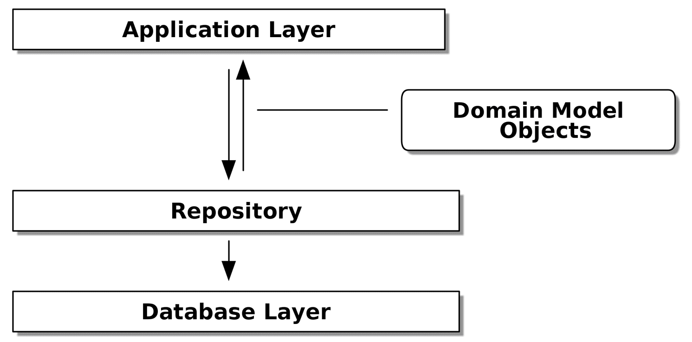
Repository Pattern

Slide 21
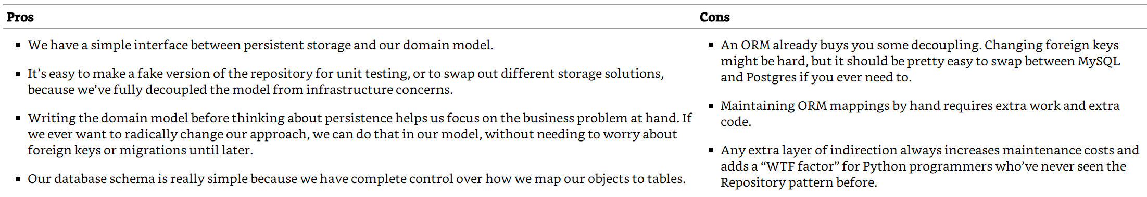
Assists in Testing
We can quickly substitute a “fake” database in order to test domain model assumptions
Pros and Cons

Slide 22
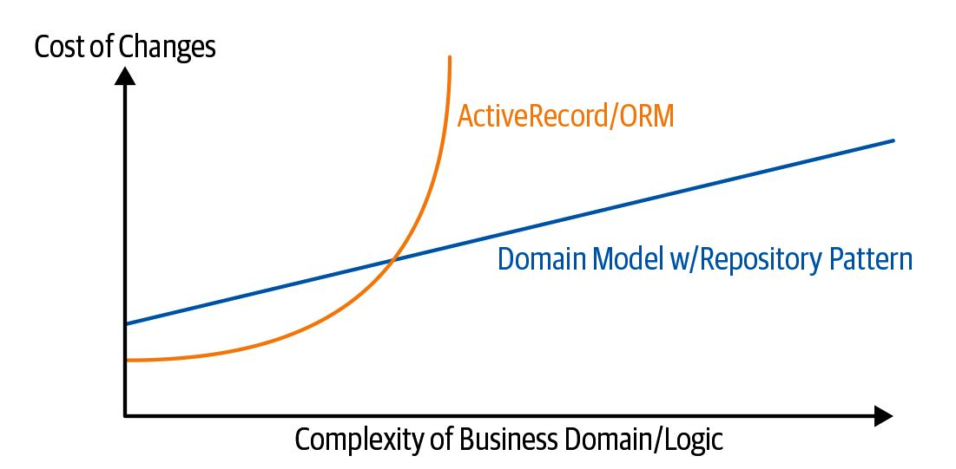
Scope and Shape

